Slide 1

AWS in 60 Minutes
Kimi AI
2025/01/01

Slide 2
CONTENTS
01
Cloud & AWS Basics
04
Networking & Security
02
Core Compute Power
05
Watch, Notify, Deploy
03
Storage & Databases
06
Next Steps

Slide 3
01
Cloud & AWS Basics

Slide 4
Why Cloud Beats On-Prem
From CapEx to Global Reach in Minutes
Zero Upfront Cost
Global Reach
200+ Services
Eliminate hardware investment and replace it with a pay-as-you-go model.
Deploy applications in 31 regions worldwide in minutes.
Start with the AWS Free Tier and scale to any workload.

Slide 5
Three Ways to Use AWS
IaaS
PaaS
SaaS
Infrastructure as a Service
Platform as a Service
Software as a Service
Raw building blocks like EC2 & S3 for full control.
Focus on code with Lambda & Elastic Beanstalk.
Ready-to-use apps like WorkSpaces; just log in.

Slide 6
02
Core Compute Power

Slide 7

EC2: Your Virtual Server
Launch resizable VMs in seconds. Start with the free t2.micro and scale to powerful GPU instances as you grow.
Choose CPU, Memory, OS
Configure Security Groups
Enable Auto Scaling

Slide 8
Lambda: Code Without Servers
Run code in response to events. AWS manages the servers, you focus on the function.
→
→
1. Upload Code
2. Set Trigger
3. Pay Per Use
Python, Node.js, Java
S3, API call, etc.
Only for milliseconds
Ideal for microservices, data processing, and chatbots.

Slide 9
03
Storage & Databases

Slide 10
S3: Unlimited Object Store
Store any file with 99.999999999% durability in scalable buckets.
Use Cases
Backups, Static Websites, Data Lakes
Cost Optimization
Lifecycle rules to auto-archive to Glacier

Slide 11
RDS vs. DynamoDB: Quick Pick
VS
RDS
DynamoDB
Relational Database Service
NoSQL Database
Traditional SQL (MySQL, PostgreSQL)
Automated backups & patching
Multi-AZ failover for high availability
Millisecond latency at planet scale
Handles millions of requests/second
Built-in caching & global tables
Choose for structured data & complex queries.
Choose for speed, scale, and simplicity.

Slide 12
04
Networking & Security

Slide 13
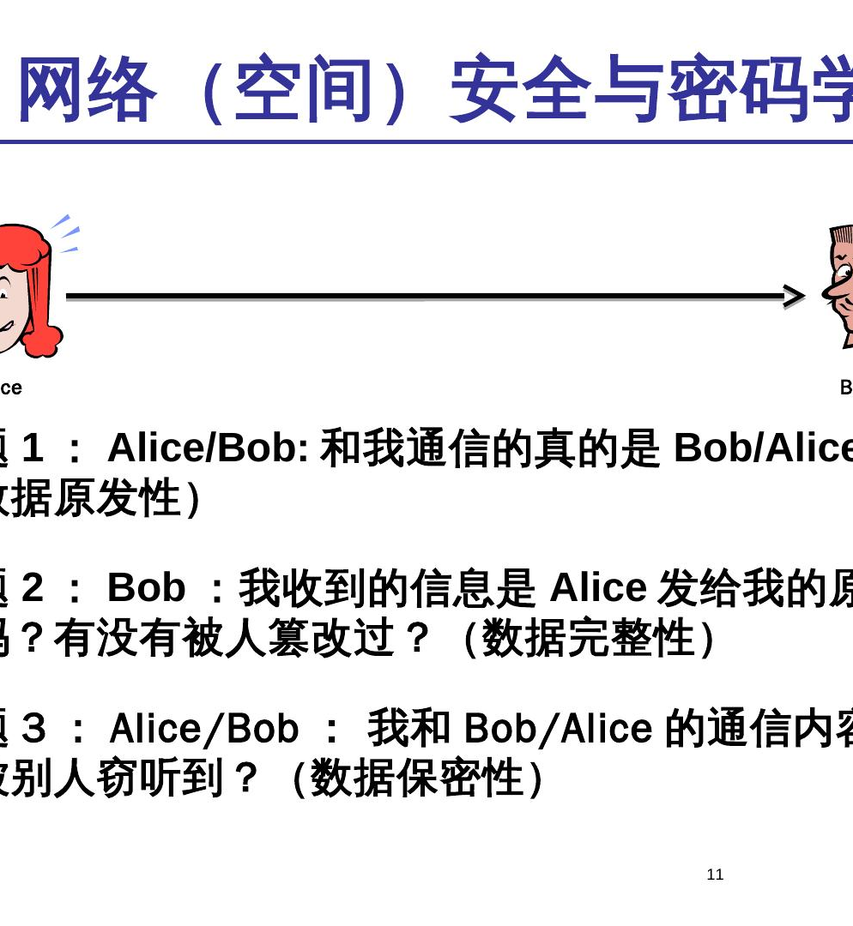
VPC: Your Private Cloud Corner
Carve an isolated network inside AWS. You control the IP ranges, subnets, and routing.
Public & Private Subnets
Use an Internet Gateway for public access, keep databases private.
Security Groups
Act as virtual firewalls to protect every resource.

Slide 14
IAM: Lock the Front Door
Identity and Access Management is your first line of defense.
Least Privilege
Enable MFA
No Hardcoded Keys
Grant only the permissions needed.
Secure your root account and users.
Use IAM roles for services.
Proper IAM prevents accidental deletes and costly breaches from day one.

Slide 15
05
Watch, Notify, Deploy

Slide 16
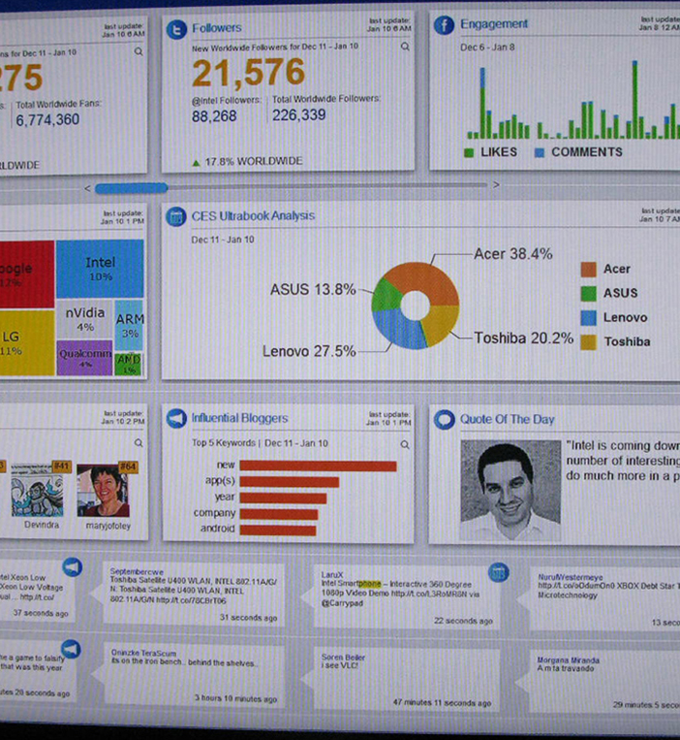
Watch & Notify
CloudWatch monitors your resources, SNS delivers the alerts. React to issues before customers notice.
CloudWatch
Collects logs & metrics, triggers alarms on CPU spikes or errors.
SNS
Sends email or text messages to on-call teams instantly.

Slide 17
CloudFormation: Stack as Code
Define your entire infrastructure in a JSON or YAML template.
Template
Provision
Rollback
Describe resources
Automated & consistent
Safe & versioned
Version your infrastructure like application code, enabling team collaboration and safe rollbacks.

Slide 18
06
Next Steps

Slide 19
Your First Project: Free
Get hands-on confidence with zero cost for 12 months using the AWS Free Tier.
1.
Launch a t2.micro EC2 instance
2.
Install a simple web server
3.
Store an image in S3
4.
Serve it via CloudFront CDN

Slide 20
Certification & Learning Path
1. Cloud Practitioner
2. Solutions Architect
Validate your basic understanding of the AWS Cloud.
Dive deep into designing distributed systems.
Core services & use cases
Architecting on AWS
Cloud economics & billing
Hands-on labs & workshops
Basic security & compliance
re:Invent videos & deep dives
Use AWS Skill Builder and hands-on workshops to deepen your expertise.

Slide 21
THANK YOU
Kimi AI
2025/01/01

